Slide 1


THIS TEMPLATE DESIGNED FOR FEI ER SHE JI
招
商
工
作
汇
报
The user can demonstrate on a projector or computer, or print the presentation and make it into a film to be used in a wider field
jieshewen

Slide 2
目
录
CONTENT
标题文字添加此处
标题文字添加此处
标题文字添加此处
标题文字添加此处

Slide 3

第
一
章
标题文字添加此处
The user can demonstrate on a projector or computer, or print the presentation and make it into a film to be used in a wider field

Slide 4
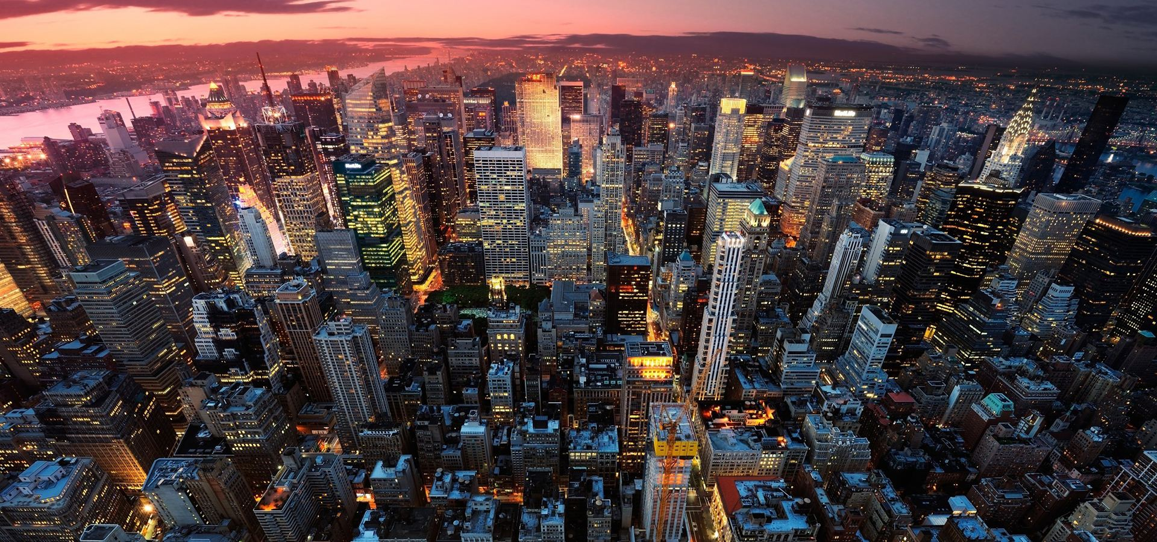
标题文字添加此处
The user can demonstrate on a projector or computer, or print the presentation and make it into a film to be used in a wider field
标题添加此处
The user can demonstrate on a projector or computer, or print the presentation and make it into a film to be used in a wider field
标题添加此处
The user can demonstrate on a projector or computer, or print the presentation and make it into a film to be used in a wider field

Slide 5

标题文字添加此处
The user can demonstrate on a projector or computer, or print the presentation and make it into a film to be used in a wider field
标题添加此处
The user can demonstrate on a projector or computer, or print the presentation and make it into a film to be used in a wider field
标题添加此处
78%
标题添加此处
69%
标题添加此处
46%
标题添加此处
90%

Slide 6
标题文字添加此处
The user can demonstrate on a projector or computer, or print the presentation and make it into a film to be used in a wider field
标题添加此处
标题添加此处
标题添加此处
标题添加此处
标题添加此处
标题添加此处
标题添加此处
标题添加此处
标题添加此处
标题添加此处
标题添加此处
标题添加此处

Slide 7
标题文字添加此处
The user can demonstrate on a projector or computer, or print the presentation and make it into a film to be used in a wider field
42%
91%
48%
73%
标题添加此处
标题添加此处
标题添加此处
标题添加此处
The user can demonstrate on a projector or computer, or print the presentation and make it into a film to be used
The user can demonstrate on a projector or computer, or print the presentation and make it into a film to be used
The user can demonstrate on a projector or computer, or print the presentation and make it into a film to be used
The user can demonstrate on a projector or computer, or print the presentation and make it into a film to be used

Slide 8
标题文字添加此处
The user can demonstrate on a projector or computer, or print the presentation and make it into a film to be used in a wider field
40%
30%
85%
65%
35%

Slide 9
第
二
章
标题文字添加此处
The user can demonstrate on a projector or computer, or print the presentation and make it into a film to be used in a wider field

Slide 10




标题文字添加此处
The user can demonstrate on a projector or computer, or print the presentation and make it into a film to be used in a wider field
标题添加
标题添加
The user can demonstrate on a projector or computer, or print the presentation and make it into a film to be used in a wider field
The user can demonstrate on a projector or computer, or print the presentation and make it into a film to be used in a wider field
标题添加
标题添加
The user can demonstrate on a projector or computer, or print the presentation and make it into a film to be used in a wider field
The user can demonstrate on a projector or computer, or print the presentation and make it into a film to be used in a wider field

Slide 11
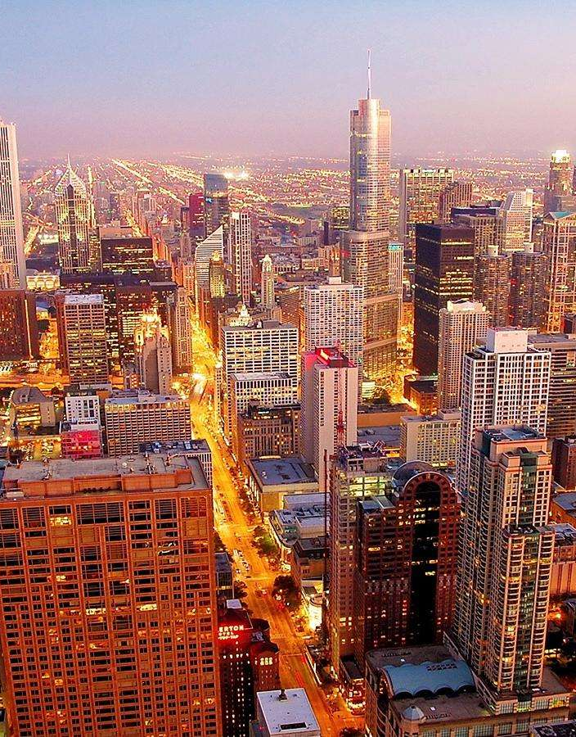
标题文字添加此处
The user can demonstrate on a projector or computer, or print the presentation and make it into a film to be used in a wider field
标题添加此处
标题添加此处
The user can demonstrate on a projector or computer, or print the presentation and make it into a film to be used in a wider field
The user can demonstrate on a projector or computer, or print the presentation and make it into a film to be used in a wider field

Slide 12
标题文字添加此处
The user can demonstrate on a projector or computer, or print the presentation and make it into a film to be used in a wider field
标题添加此处
标题添加此处
标题添加此处
01
02
03
The user can demonstrate on a projector or computer, or print the presentation and make it into a film to be used in a wider field
The user can demonstrate on a projector or computer, or print the presentation and make it into a film to be used in a wider field
The user can demonstrate on a projector or computer, or print the presentation and make it into a film to be used in a wider field

Slide 13
标题文字添加此处
The user can demonstrate on a projector or computer, or print the presentation and make it into a film to be used in a wider field
标题添加此处
标题
添加此处
The user can demonstrate on a projector or computer, or print the presentation and make it into a film to be used in a wider field
标题添加此处
标题
添加此处
标题
添加此处
The user can demonstrate on a projector or computer, or print the presentation and make it into a film
标题添加此处
标题
添加此处
标题
添加此处
标题
添加此处
The user can demonstrate on a projector or computer, or print the presentation

Slide 14
第
三
章
标题文字添加此处
The user can demonstrate on a projector or computer, or print the presentation and make it into a film to be used in a wider field

Slide 15
标题文字添加此处
The user can demonstrate on a projector or computer, or print the presentation and make it into a film to be used in a wider field
标题添加此处
The user can demonstrate on a projector or computer, or print the presentation and make it into a film to be used in a wider field
标题添加此处
The user can demonstrate on a projector or computer, or print the presentation and make it into a film to be used in a wider field
标题添加此处
The user can demonstrate on a projector or computer, or print the presentation and make it into a film to be used in a wider field

Slide 16
标题文字添加此处
The user can demonstrate on a projector or computer, or print the presentation and make it into a film to be used in a wider field
标题添加此处
标题添加此处
The user can demonstrate on a projector or computer, or print the presentation and make it into a film to be used in a wider field
The user can demonstrate on a projector or computer, or print the presentation and make it into a film to be used in a wider field
标题添加此处
标题添加此处
The user can demonstrate on a projector or computer, or print the presentation and make it into a film to be used in a wider field
The user can demonstrate on a projector or computer, or print the presentation and make it into a film to be used in a wider field

Slide 17
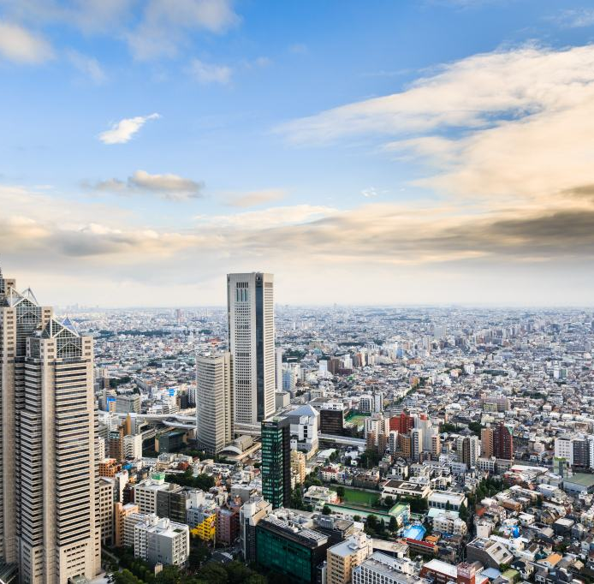
标题文字添加此处
The user can demonstrate on a projector or computer, or print the presentation and make it into a film to be used in a wider field
标题添加此处
标题添加此处
The user can demonstrate on a projector or computer, or print the presentation and make it into a film to be used in a wider field
The user can demonstrate on a projector or computer, or print the presentation and make it into a film to be used in a wider field

Slide 18
标题文字添加此处
The user can demonstrate on a projector or computer, or print the presentation and make it into a film to be used in a wider field
关键词
1
2
3
4
5
6
7
8
9
10
11
12
13
14
15
16
17
18
19
20
21
关键词
关键词
关键词
关键词

Slide 19
第
四
章
标题文字添加此处
The user can demonstrate on a projector or computer, or print the presentation and make it into a film to be used in a wider field

Slide 20
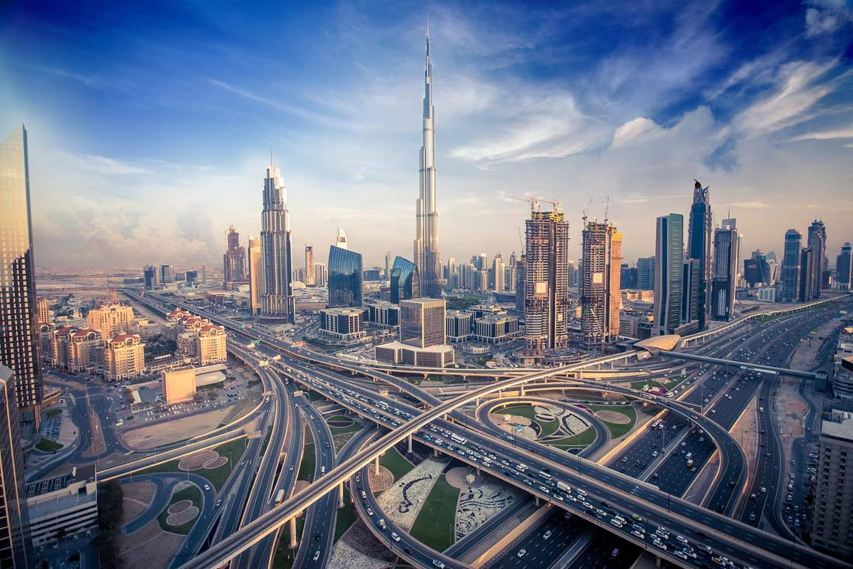
标题文字添加此处
The user can demonstrate on a projector or computer, or print the presentation and make it into a film to be used in a wider field
标题添加此处
标题添加此处
The user can demonstrate on a projector or computer, or print the presentation and make it into a film to be used in a wider field
The user can demonstrate on a projector or computer, or print the presentation and make it into a film to be used in a wider field

Slide 21
标题文字添加此处
The user can demonstrate on a projector or computer, or print the presentation and make it into a film to be used in a wider field
01
02
03
标题添加此处
标题添加此处
标题添加此处
The user can demonstrate on a projector or computer, or print the presentation and make it into a film to be used in a wider field
The user can demonstrate on a projector or computer, or print the presentation and make it into a film to be used in a wider field
The user can demonstrate on a projector or computer, or print the presentation and make it into a film to be used in a wider field
06
05
04
标题添加此处
标题添加此处
标题添加此处
The user can demonstrate on a projector or computer, or print the presentation and make it into a film to be used in a wider field
The user can demonstrate on a projector or computer, or print the presentation and make it into a film to be used in a wider field
The user can demonstrate on a projector or computer, or print the presentation and make it into a film to be used in a wider field

Slide 22
标题文字添加此处
The user can demonstrate on a projector or computer, or print the presentation and make it into a film to be used in a wider field
标题添加此处
标题添加此处
标题添加此处
标题添加此处
The user can demonstrate on a projector or computer, or print the presentation and make it into a film to be used in a wider
The user can demonstrate on a projector or computer, or print the presentation and make it into a film to be used in a wider
The user can demonstrate on a projector or computer, or print the presentation and make it into a film to be used in a wider
The user can demonstrate on a projector or computer, or print the presentation and make it into a film to be used in a wider

Slide 23
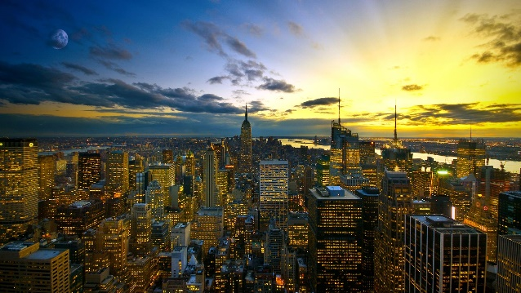

标题文字添加此处
The user can demonstrate on a projector or computer, or print the presentation and make it into a film to be used in a wider field
标题添加此处
The user can demonstrate on a projector or computer, or print the presentation and make it into a film to be used in a wider field

Slide 24
标题文字添加此处
The user can demonstrate on a projector or computer, or print the presentation and make it into a film to be used in a wider field
标题添加此处
The user can demonstrate on a projector or computer, or print the presentation and make it into a film to be used in a wider fieldThe user can demonstrate on a projector or computer, or print the presentation and make it into a film to be used in a wider field

Slide 25
THIS TEMPLATE DESIGNED FOR FEI ER SHE JI
感
谢
您
的
观
看
The user can demonstrate on a projector or computer, or print the presentation and make it into a film to be used in a wider field

